Slide 1

FIN 5220-7990: SMIF Fund
Hassan Salami, Kyle Brown, Arman Ahrabian
Dec. 5, 2017

Slide 2

Overview
Company Review
Management Team
Sector Trends
Macro Conditions
Balance Sheet
Financial Analysis
Valuation
Thesis

Slide 3
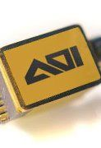
Applied Optoelectronics (AAOI)
Company Description
leading provider of fiber optic products, expanded Datacenters, and unique Semiconductor manufacturing techniques. Serving primarily 40g, 100g, and main supplier of 400g business data connection.
Supplies Microsoft and Facebook with faster data connections and database optimization.
Intrinsic Value
IV = $2.94
Organic growth.

Slide 4
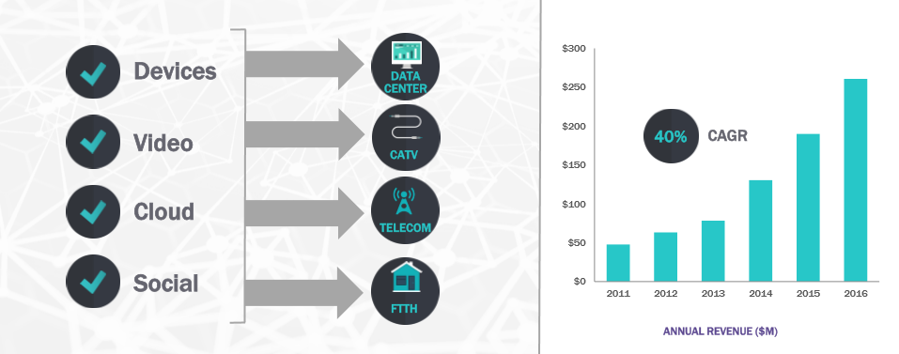
Bandwidth Demand - Key Driver
Business Score: 9
Source: AAOI Investor Relations 3Q2017

Slide 5


Management Team
Executive Team
CEO, Dr. Chin-Hsiang (Thompson) Lin.
CFO & CSO, Dr. Stephan J. Murry.
Notable Board Members (7 Total)
Chairman Dr. Lin, William Yeh, Richard Black & Allan Moore.
Director, Allan Moore bought $1m in shares on Nov. 14, 2017.
Institutional ownership: 97.67%
Insider ownership: 5.77%
Executive Compensation
Long-term equity compensation.
Management Score: 8
Source: Proxy Statement

Slide 6
Sector Trends
Semiconductor equipment
Headwinds
China’s impact on the supply chain decreases prices.
Tailwinds
Companies shifting to faster data connections and expanded datacenters.
U.S. Semiconductors - 22 consecutive months of production growth.
Source: Bloomberg

Slide 7
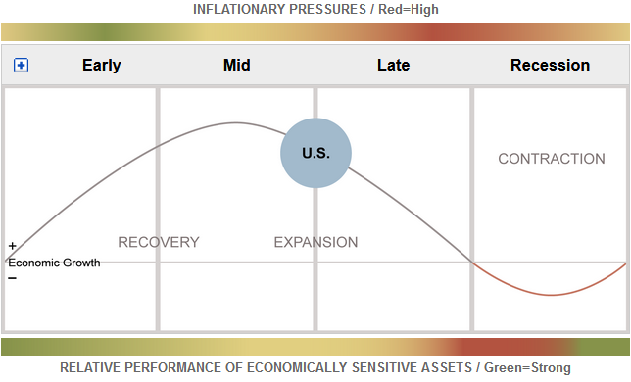
Macro Conditions
GDP Growth
2016: 3.1%
2017: 2.3%
2018: 2.5%
Increase in GDP effects consumer spending and cycle positively.
Growth projections boost Technology outlook.
New tax reform laws may increase earnings by 15%.
Source: Fidelity, Statista

Slide 8
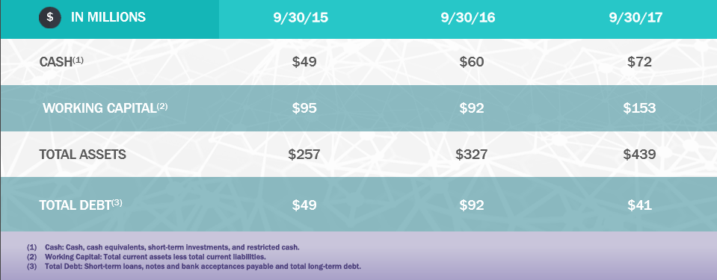
Balance Sheet
Balance Sheet Score: 9
Source: AAOI Investor Relations 3Q2017

Slide 9
Financial Analysis
Top 2 customers (Microsoft 37%, Facebook 24%) account for 61% of Revenue.
Source: Bloomberg

Slide 10
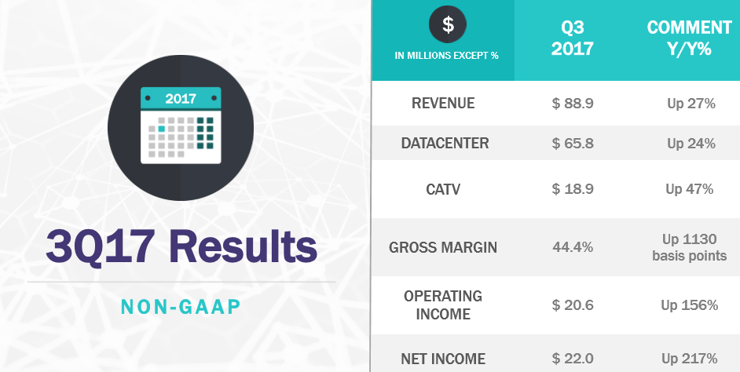
Current Financial Highlights
Financials Score: 9
Source: AAOI Investor Relations 3Q2017

Slide 11
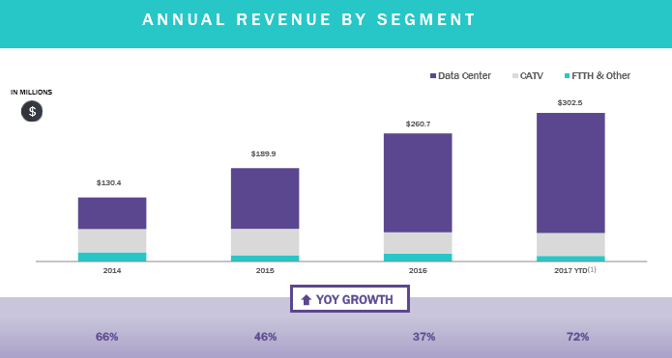
Revenue Growth
Source: AAOI Investor Relations 3Q2017

Slide 12
Valuation Metrics
Source: Bloomberg

Slide 13
AAOI PE vs Benchmark vs Sector
Source: Bloomberg

Slide 14
AAOI vs Benchmark vs Sector
Source: Guru Focus

Slide 15
Valuation
Consistent growth in production volume will continue for AAOI and U.S. Semiconductors.
More companies are shifting from 40g to 100g networks and expanded Datacenter capabilities.
Fast growth and AAOI products have driven earnings and value for key customers.
Low price to high value and 19% upside is a steal at a cheap price.
Source: Bloomberg

Slide 16
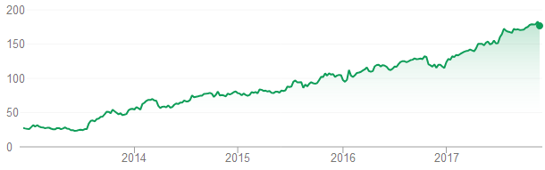
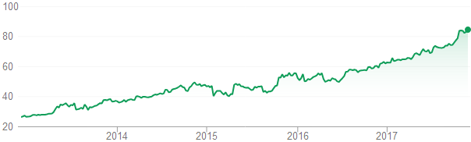
Customer Growth
Facebook
Microsoft
Source: Google Finance

Slide 17
Relative Valuation
Valuation Score: 9
Source: Bloomberg

Slide 18

Thesis
Microsoft and Facebook growth associated with utilizing next gen AAOI products.
Rapidly growing Datacenter market fuel record high revenues.
China’s initial impact on the supply chain is consistently short lived.

Slide 19
Risks to Thesis
Over reliance on Microsoft and Facebook may have significant consequences.
Cyclical nature of sales in the Semiconductor sector.
Uncertainty: Market, financial performance, and new tax reform.

Slide 20
Stock Screener

Slide 21
Summary
Innovative business.
Trading at great value.
Financials and valuations demonstrates tremendous potential at a low price.
Overall score:

Slide 22
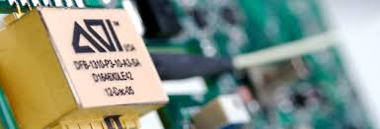
Any Questions or Comments?
Thank You

